Slide 1
Blue Team Detect and Defend
Scott Lynch | @packetengineer | lynch@packetengineer.com
5 October 2018

Slide 2
About the author
Adjunct Instructor - Bucks County Community College, Cisco IT Academy
Security Operations Manager, Swedish Space Corp
Ex Navy Electronic Warfare Tech and P-3 IFO
CCNP-Security, GIAC GNFA and GCIH

Slide 3
What is a Blue Team
“A blue team is a group of individuals who perform an analysis of information systems to ensure security, identify security flaws, verify the effectiveness of each security measure, and to make certain all security measures will continue to be effective after implementation.”¹
(1) Sypris Electronics. "DoDD 8570.1: Blue Team". Sypris Electronics. Retrieved July 3, 2016.

Slide 4
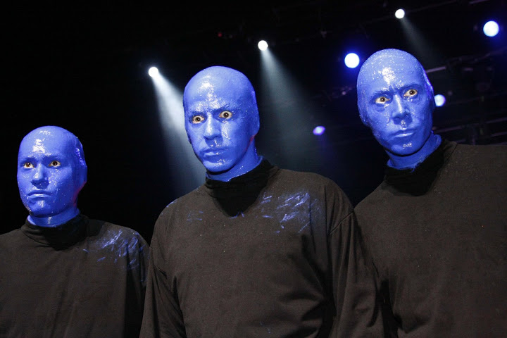
Who is the blue team
IT professionals from different backgrounds
May not share the same training or specialty
Usually made up of system administrators and network engineers
Can include developers and other parts of org
I said Blue Team not Blue Man

Slide 5
Principle drive
Goal - Visibility and Knowledge of all systems within the enterprise
Task – Monitoring of internal and external network assets to build a big picture/baseline of ALL network traffic
Expected Outcome – Fused picture of total network traffic and operations in order to defend the enterprise and provide incident response

Slide 6
How do we get there
Deploy systems to aid in the visibility and identification of network traffic
Develop a continuous monitoring plan of internal and external enterprise assets
Train as a team to fight as a team
Continuous development of team members through training and practical exercises

Slide 7
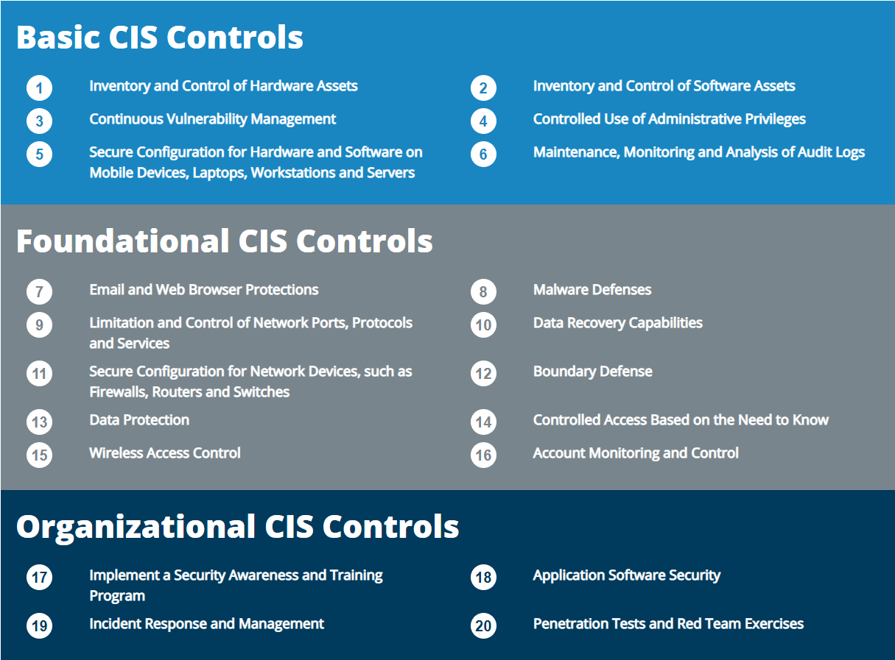
CIS Critical Controls

Slide 8
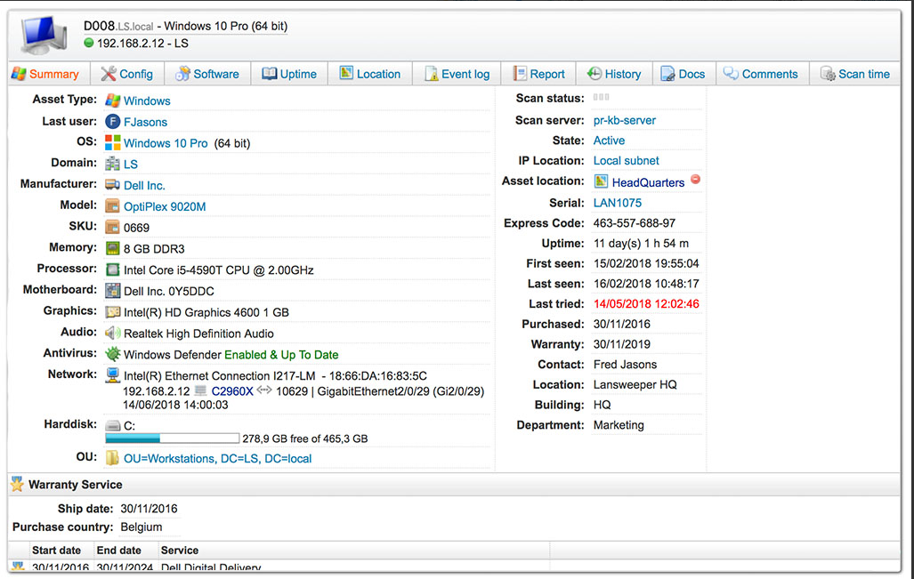
Inventory of Assets and software
Lansweeper
Inventory tool using SNMP, WMI and SSH
Software and hardware info

Slide 9
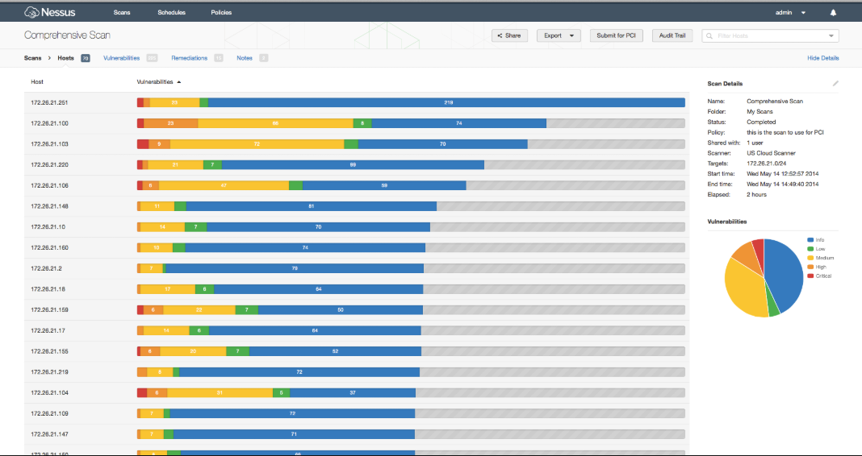
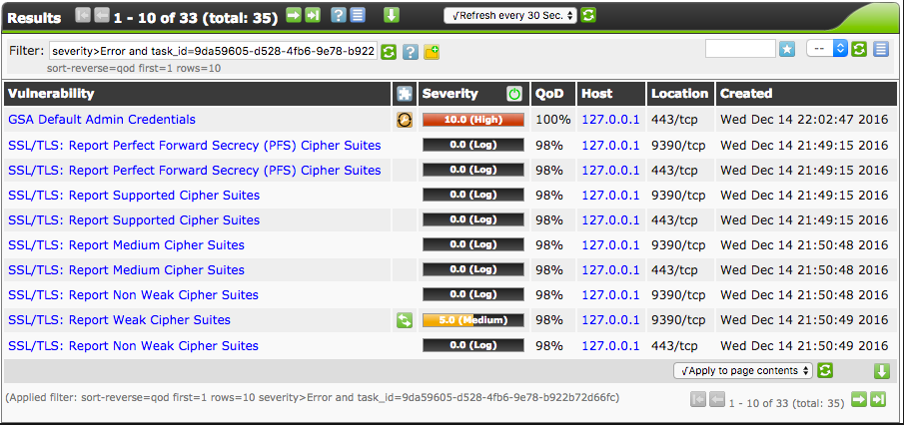
Vulnerability assessment
Nessus by Tenable
OpenVAS by Greenbone Networks

Slide 10
Threat hunting
Cyber threat hunting is "the process of proactively and iteratively searching through networks to detect and isolate advanced threats that evade existing security solutions."
Threat hunting is aptly focused on threats. And to be a threat, an adversary must have three things:
Intent
Capability
Opportunity to do harm

Slide 11
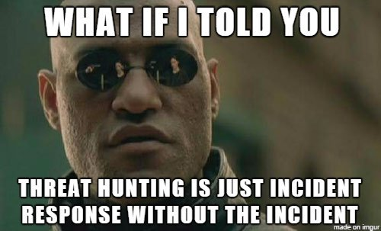
Threat Hunting
Correlation of end point logs
Netflow traffic
Analysis of NIDS and HIDS
Indications of compromise IOC
Threat Feeds
IDS and Firewall log correlation

Slide 12
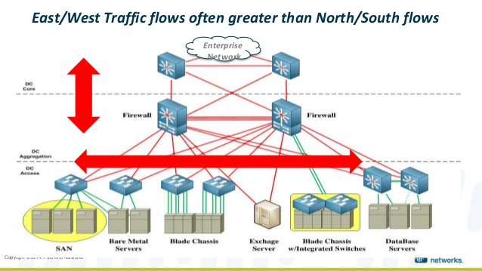
Threat Hunting Cont.
Looking for intra system/lateral movement

Slide 13
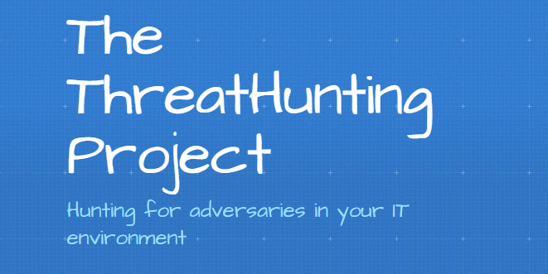

Threat hunting resources
The Threat Hunting Project https://www.threathunting.net/reading-list
Adversary Hunting with SOF-ELK https://isc.sans.edu/forums/diary/Adversary+hunting+with+SOFELK/22592/

Slide 14
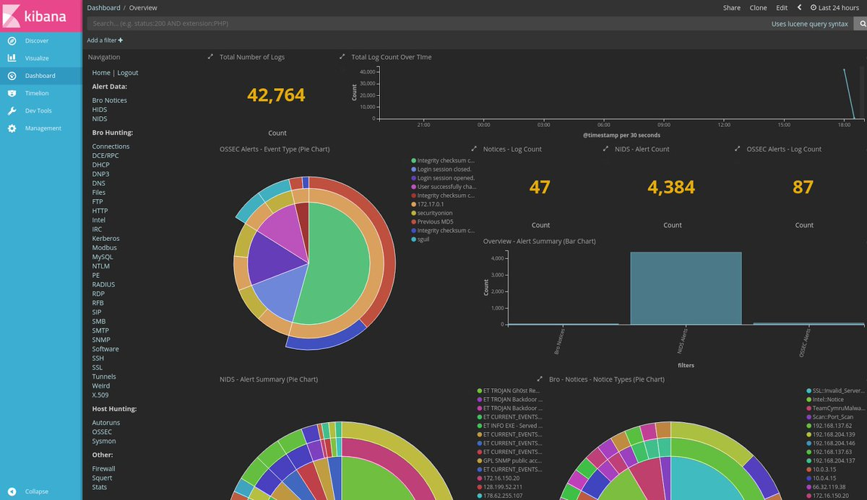

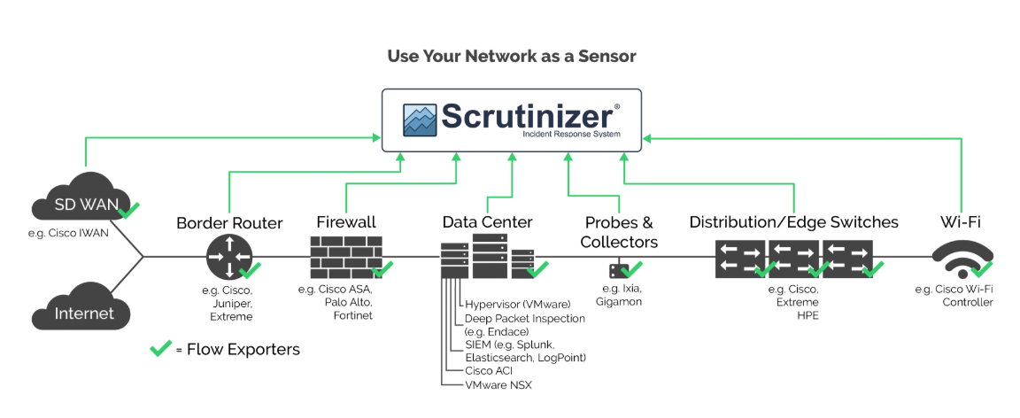
Threat hunting tools
Security Onion
BRO NSM
Scrutinizer by Plixer
Netflow
Syslog and Windows Event logs

Slide 15
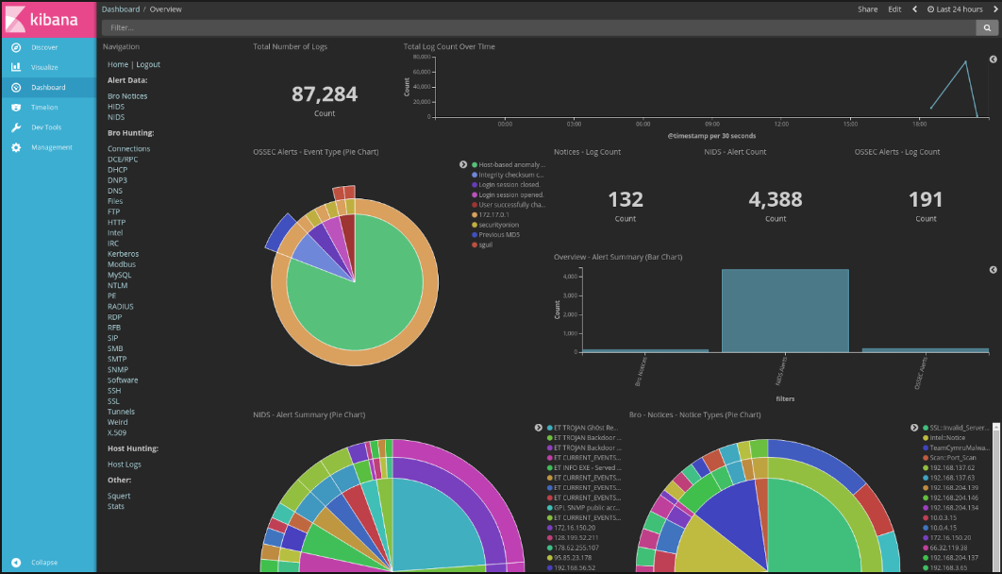
Security onion
https://securityonion.net/

Slide 16
Security onion
Open source NSM
SNORT/SURICATA IDS
BRO IDS
Critical Stack Threat Intel
Docker Images
ELK
Sysmon
OSSEC NIDS
Input
Packet Data
Full PCAP
Syslog
Output
Parsed data for ingestion into ELK database
Fully searchable and indexed data from numerous sources

Slide 17
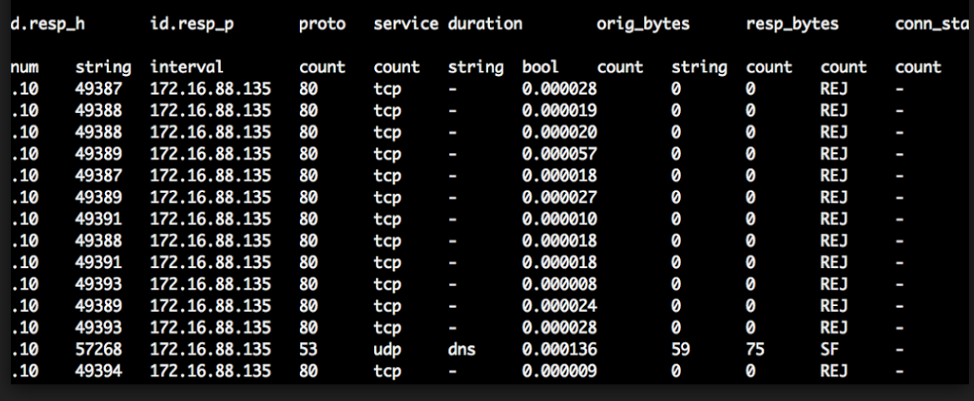
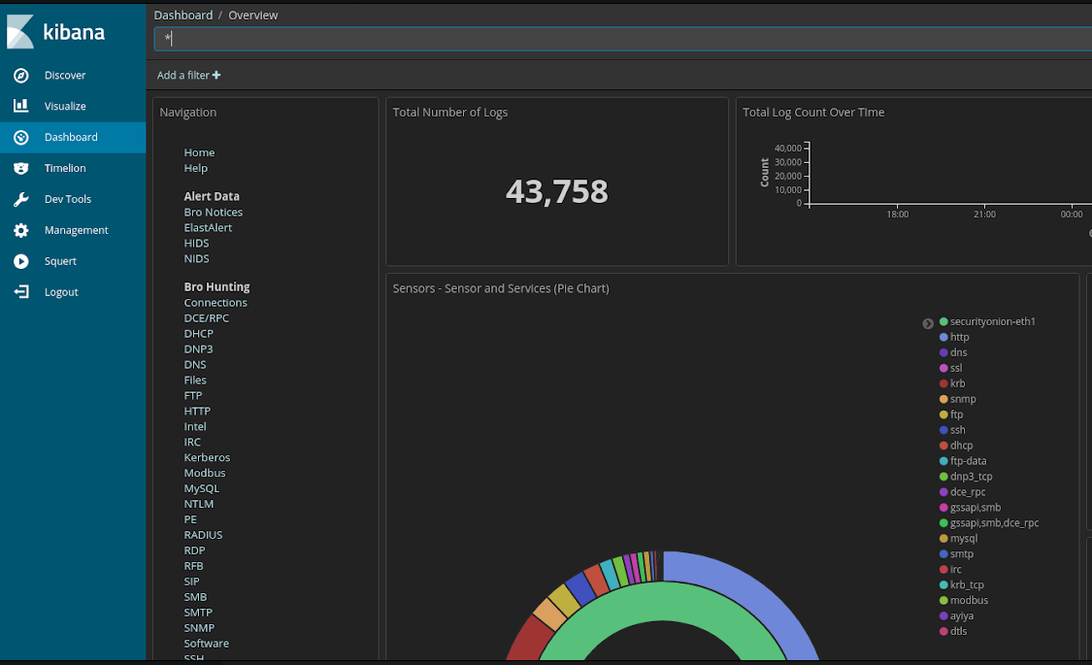
BRO NSM
Example Conn.log
https://www.bro.org/

Slide 18
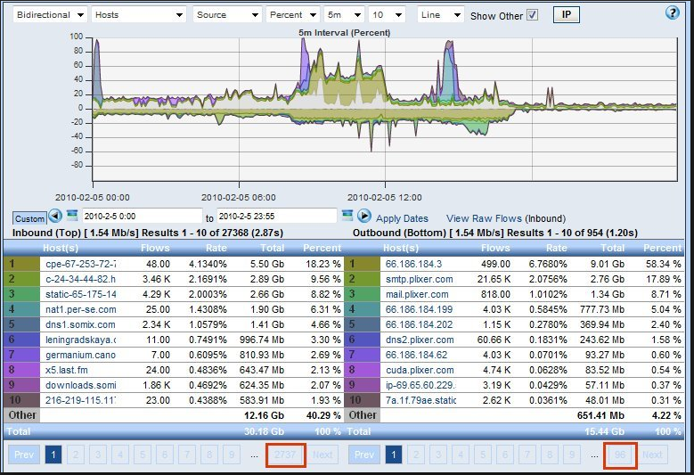
Netflow
Packet data without the payload
Small overall size compared to full pcap
Numerous tools available to capture and monitor
https://www.plixer.com/

Slide 19
tools
BRO Network Security Monitor https://www.bro.org/
Security Onion https://securityonion.net/
SOF-ELK® VM Distribution https://github.com/philhagen/sof-elk
HELK NSM https://github.com/Cyb3rWard0g/HELK/wiki
Rock NSM https://rocknsm.io/
Sysmon https://docs.microsoft.com/en-us/sysinternals/downloads/sysmon

Slide 20
Resources and Links
CIS Critical 20 Controls https://www.cisecurity.org/controls/
Peerlyst https://www.peerlyst.com
Medium https://medium.com/
H&A Security Solutions https://www.hasecuritysolutions.com/
Black Hills Information Security https://www.blackhillsinfosec.com/blog/
SANS Blue Team Wiki https://wiki.sans.blue/#!index.md

Slide 21
People to follow on twitter
Justin Henderson @SecurityMapper
John Hubbard @SecHubb
Eric Conrad @eric_conrad
Ismael Valenzuela @aboutsecurity
Lesley Carhart @hacks4pancakes
Austin Taylor @HuntOperator
SwiftOnSecurity @SwiftOnSecurity
Security Onion @securityonion
Doug Burks @dougburks
John Strand @strandjs

Slide 22
Events to follow
SANS Training Events https://www.sans.org/
BsidesPhilly https://www.bsidesphilly.org/
Security Bsides http://www.securitybsides.com/w/page/12194156/FrontPage
Meetup https://www.meetup.com/
CSO Online List of Security Events https://www.csoonline.com/article/3155500/it-careers/the-cso-guide-to-top-security-conferences.html

Slide 23
questions

